Slide 1
FPGA Packet Filter With Custom Ethernet MAC and Webserver on RISC-V
Undergraduate thesis seminar
Matthew Gilpin 45801600
Supervisor: Dr Matthew D’Souza

Slide 2
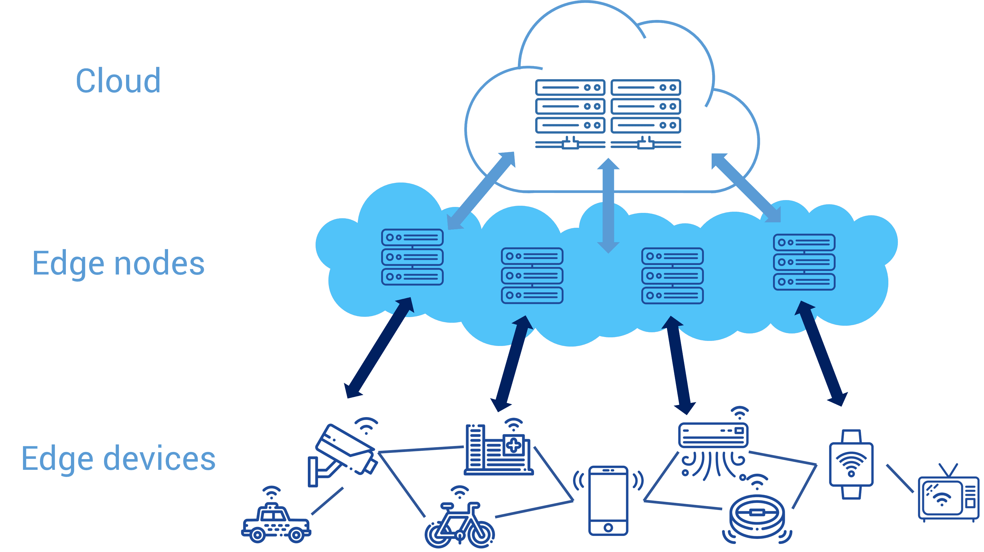
Edge networks and Security
Move computing to the edge – closer to the source of data.
Low power, highly distributed systems.
Lower network bandwidth.
Increasing security is needed.

Slide 3
Firewalls
Many kinds of firewalls
Packet filter is one of the most simple design
Some firewalls can do things like deep packet inspection
Firewalls can be done in hardware or software

Slide 4
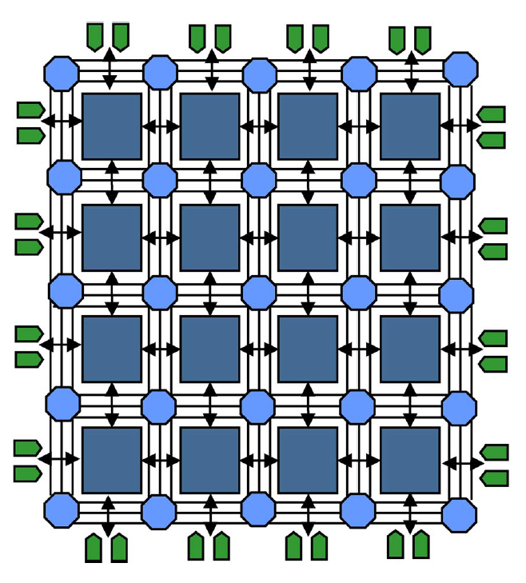
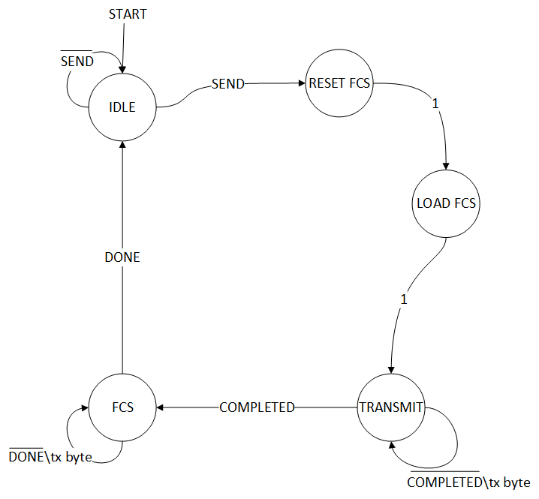
FPGAs
Field Programmable Gate Array
Custom logic - Define own architecture - Allows for parallelisation and optimisation - Power efficient
Use case in Ethernet MACs - Calculate FCS (CRC32) on the fly - Filter data at wirespeed - All while processor can be doing other things - Equates to low latency and high throughput.
System on Chips (SoC) – Integrate custom hardware with existing hardware/IP (eg, processor cores)
FPGA architecture
Ethernet Transmit FSM

Slide 5
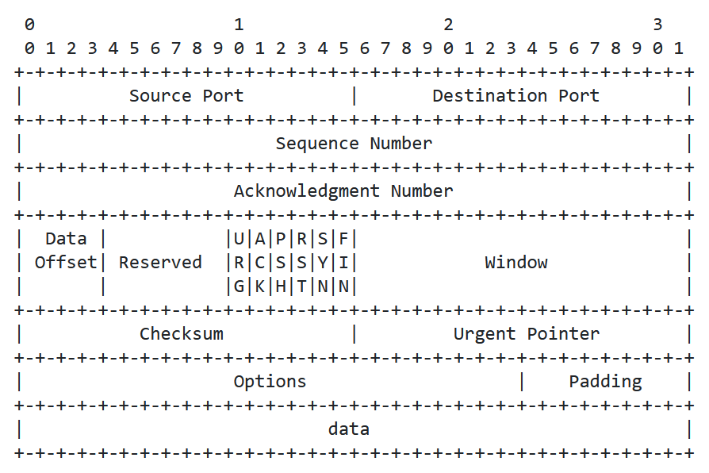
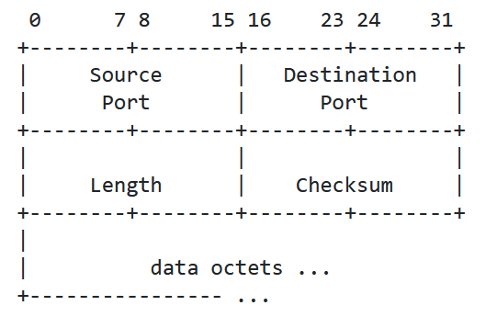
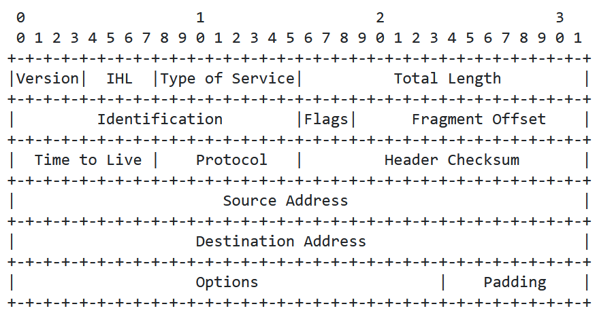
Packet filtering techniques
Talk about why 5 tuple is good and what its limitations are.
‘5 tuple’ fields to filter on - Source IP, Dest IP, Source Port, Dest Port, Protocol
Layer 4
TCP Header
UDP Header
Layer 3
IPv4 Header

Slide 6

RISC-V
Royalty-free Instruction Set Architecture (ISA)
Can be used to handle more complex but low priority tasks.
Used for running webserver
Easier to write software than hardware – faster development cycle

Slide 7
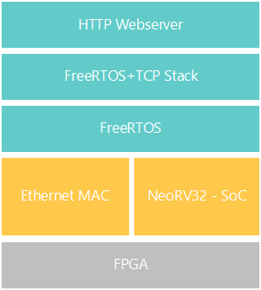
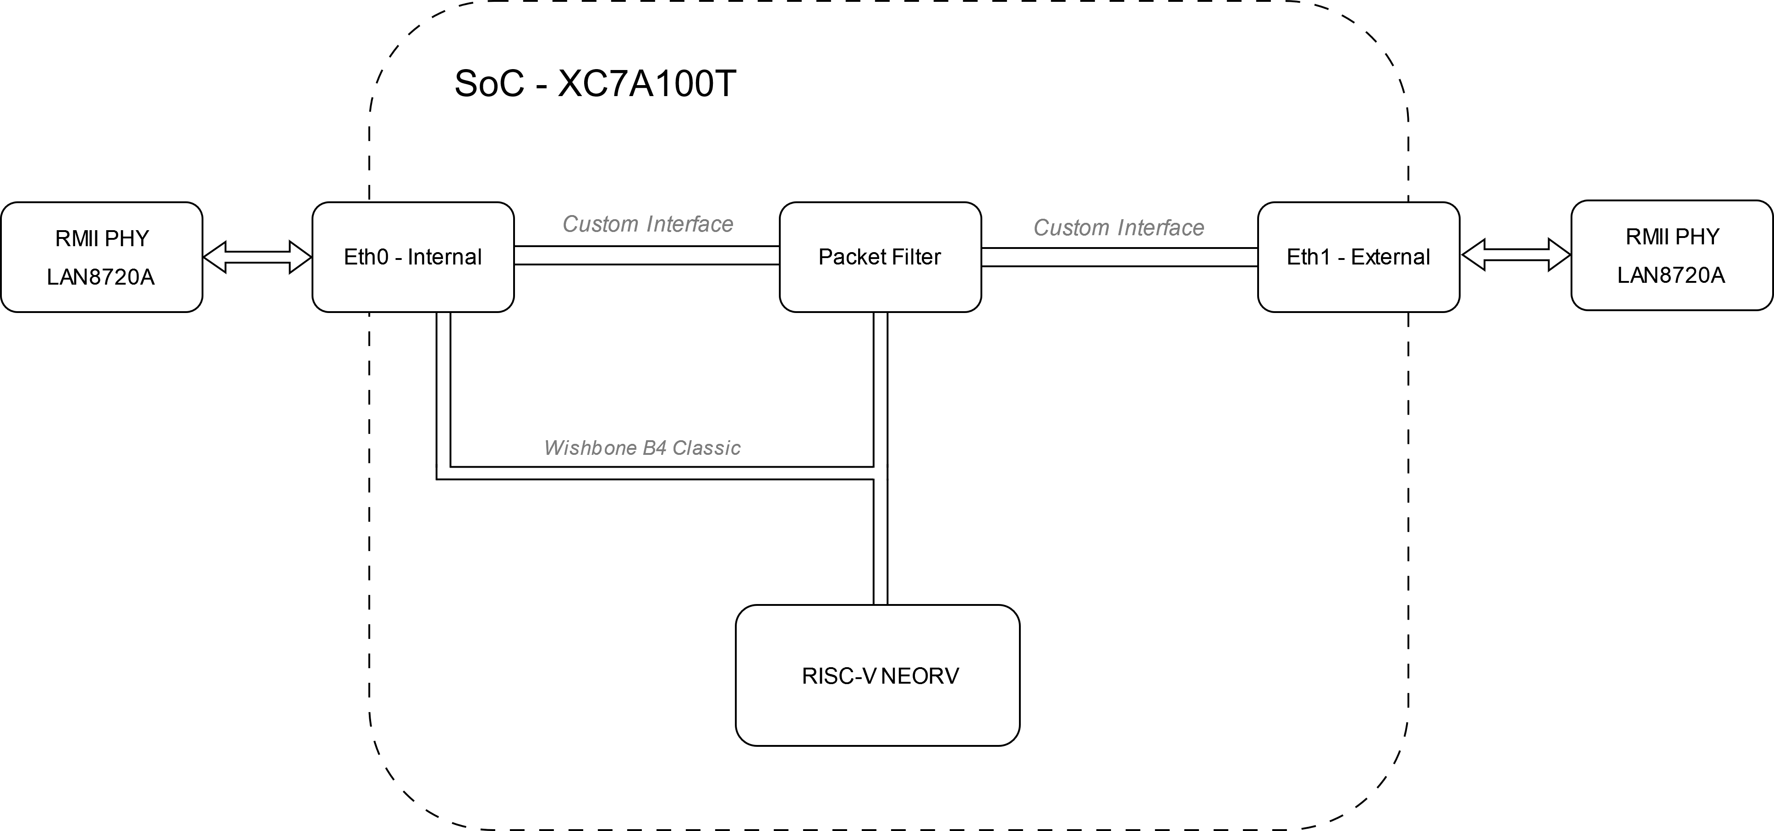
Implementation
Using Xilinx Artix 7 100T (XC7A100T-1CSG324) FGPA.
Neorv32 MCU – RISC-V softcore written in vendor agnostic VHDL
Custom Ethernet MAC connected over Wishbone bus. - Better control over packet filtering - Easier to write drivers
FreeRTOS with FreeRTOS-Plus TCP stack
Currently CPU and Wishbone at 50Mhz, intend on being 75Mhz or 100Mhz.
Integration stack
Hardware layout

Slide 8
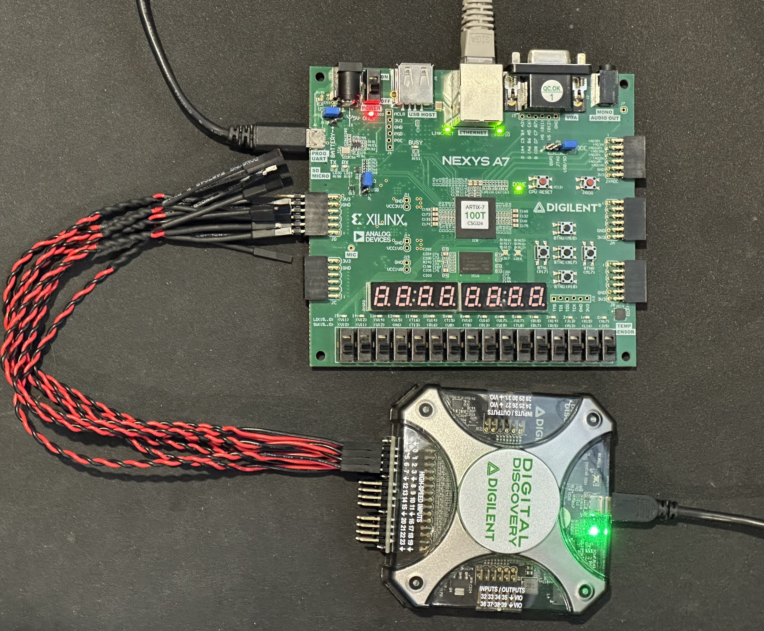
Testing
Developing for Diglient Nexys A7 - Xilinx Artix 7 100T (XC7A100T-1CSG324) FPGA
Testing with a Digilent Digital Discovery with high speed adaptor - 800MSa/s Sampling rate at 8 channels
Using simulations in Vivado to reduce time waiting for synthesis - Hard to test specific microprocessor code in a simulation.
Testing Setup

Slide 9
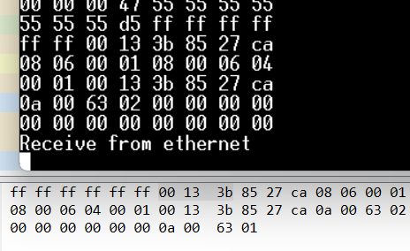
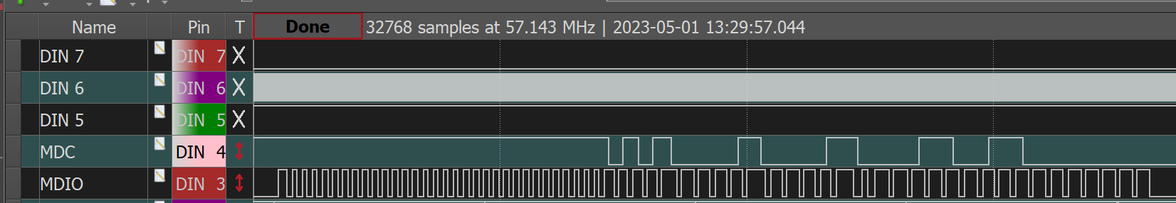
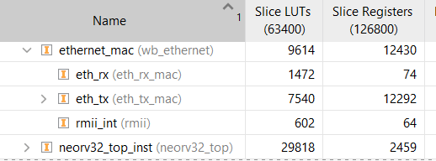
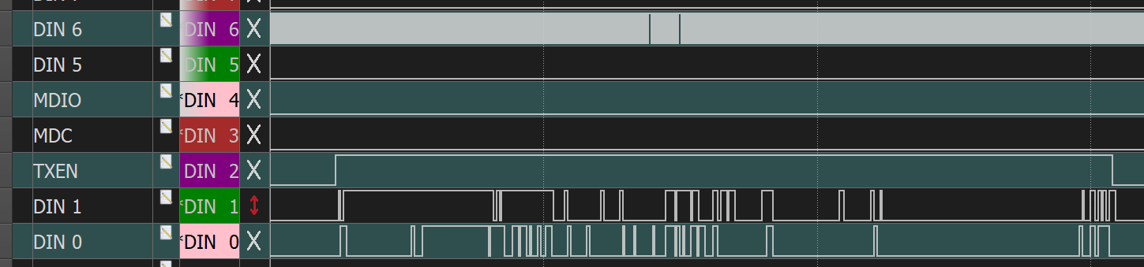
Progress
Serial Management Interface (SMI)
Ethernet Receive
Resource utilisation
62% LUT, 55% BRAM, 12% FF
Ethernet Transmit

Slide 10
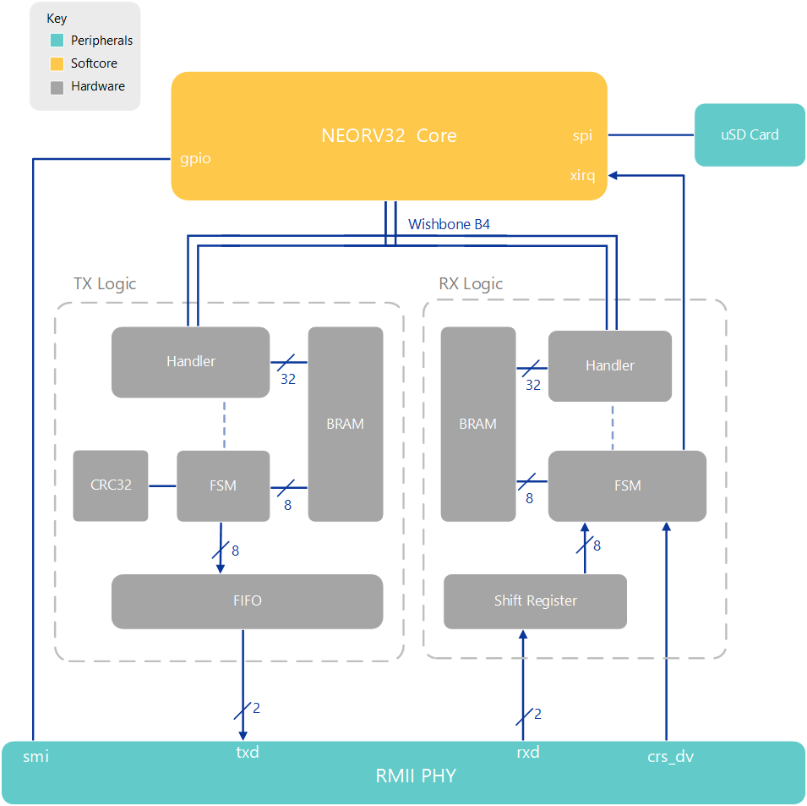
Current hardware architecture
Handler interfaces with memory and wishbone
FSM handles the data manipulation
FIFO and Shift Register used to cross clock domains
Packets get constructed and stored in BRAM
FCS (CRC32) calculated on the fly
MicroSD card to store web content – FAT filesystem
SoC Architecture

Slide 11
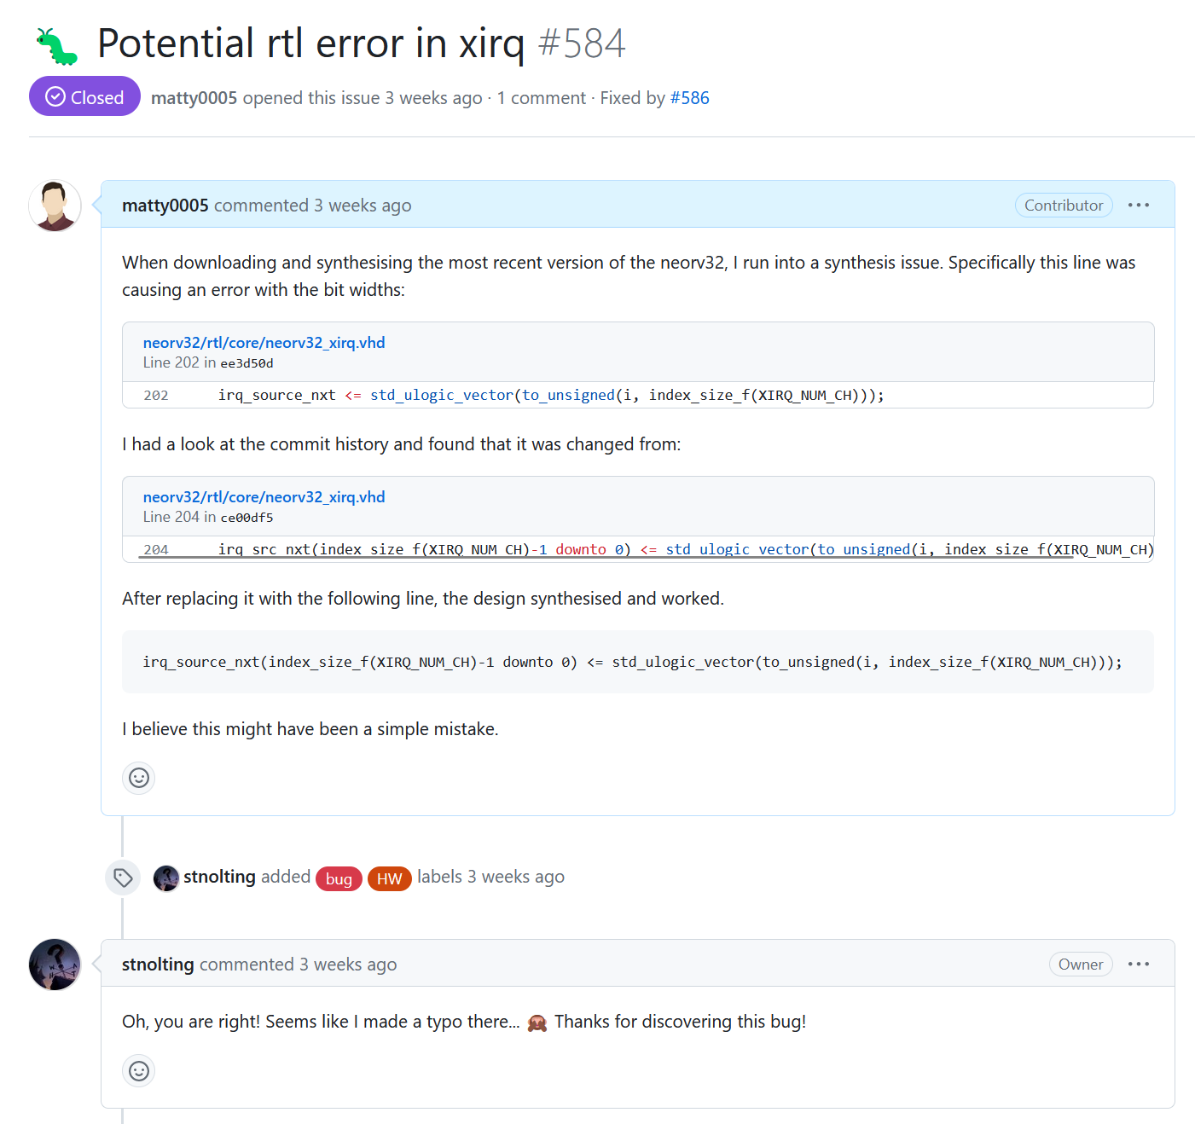
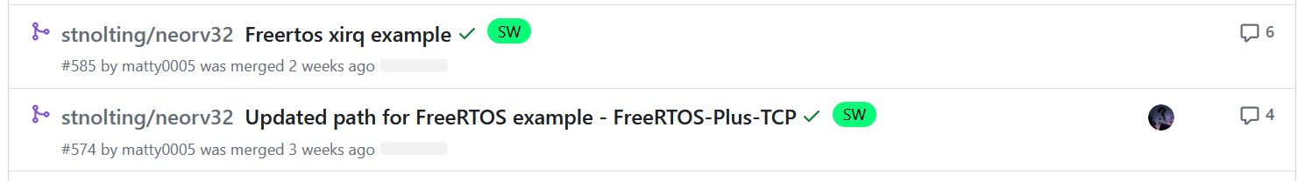
Contributions – neorv32
Detected hardware errors + added external interrupts with FreeRTOS example.
Pull requests for Neorv32 MCU.
Created example for external interrupts on Freertos
Xirq hardware bug find in Neorv32 MCU.

Slide 12
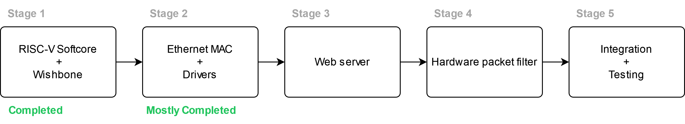
Project plan
Get Transmit logic working with RMII PHY
Finish Ethernet drivers for TCP stack
Get a filesystem working on a microSD card.
Create simple webserver
Create hardware filtering mechanism - tie that into the existing system.
Add second ethernet interface.

Slide 13
Contact
Matthew Gilpin
m.gilpin@uq.edu.au

